Slide 1

Housing Price Prediction in Colorado
Sangita Lamichhane
Regis University
MSDS 692: Data Science Practicum 1
Oct 13th, 2022

Slide 2

Project Flow
Exploratory data analysis
04
Project overview
01
Machine learning techniques
05
Analysis and Findings
06
Future considerations
07
Problem statement
03
DATA overview
02

Slide 3
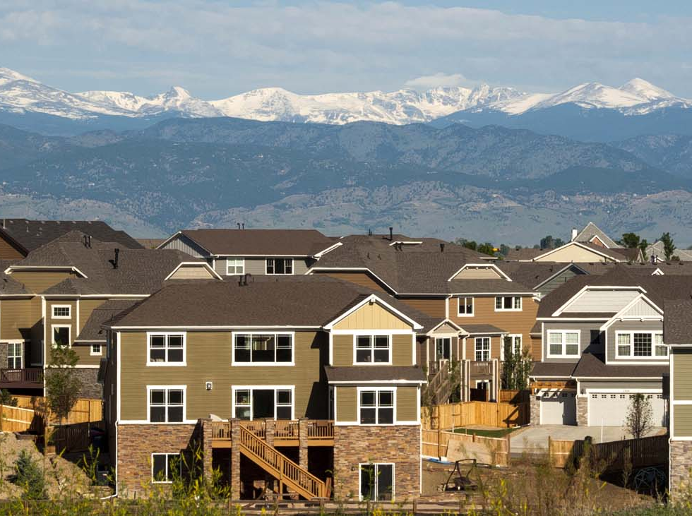
Project Overview
Colorado offers great opportunities for investment in housing market, recently we have seen many real estate investors interested to invest in this state
The goal of this project is to use predictive time series modelling on Zillow home sale price data to determine which five metro areas in Colorado State are the most optimal for short term real estate investment.

Slide 4

Data Overview
Our data comes from Zillow for modelling and prediction, whereas data from Redfin for additional exploration such as finding out correlation factors during same time period.
Zillow data contains median home price data from 1996 to 2022.
Redfin Dataset contains data from 2012-2022.
We have used data from 2012 to 2022 for our analysis.

Slide 5

Problem Statement
Where to Invest - Real-State investors are always in dilemma about where to invest their money. This study helps to predict out which 5 cities may yield high ROI percentage if invested.
What to expect – appeal investors as it will help them make choices by predicting the estimated Return of Investment (ROI) for their investment

Slide 6
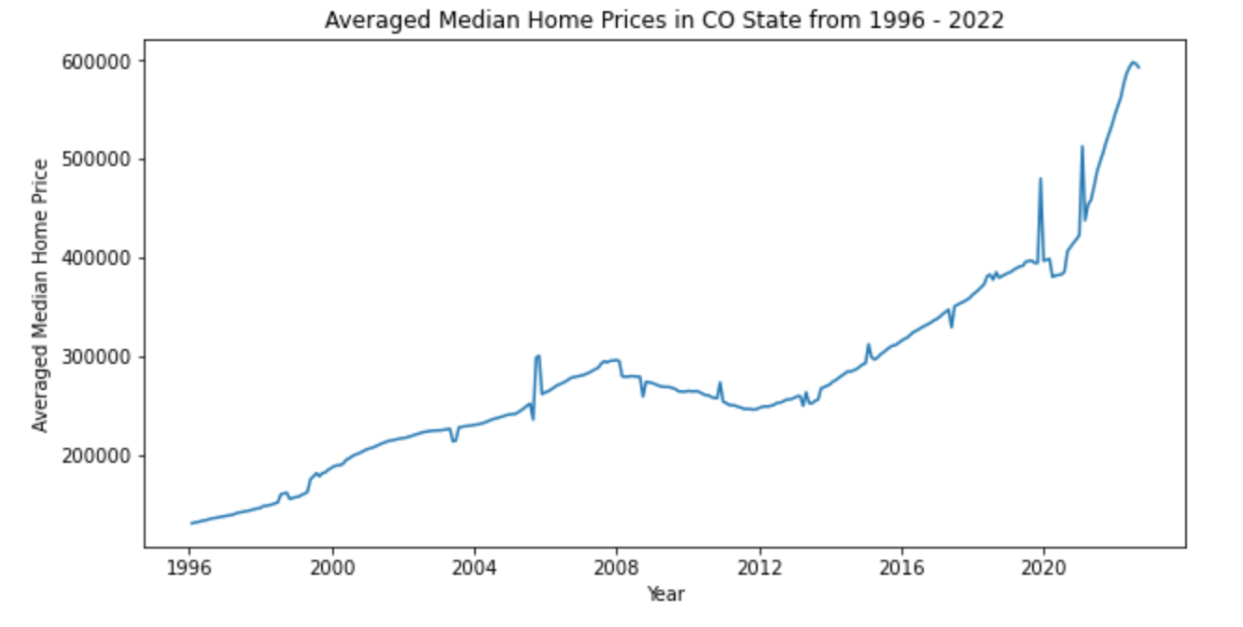
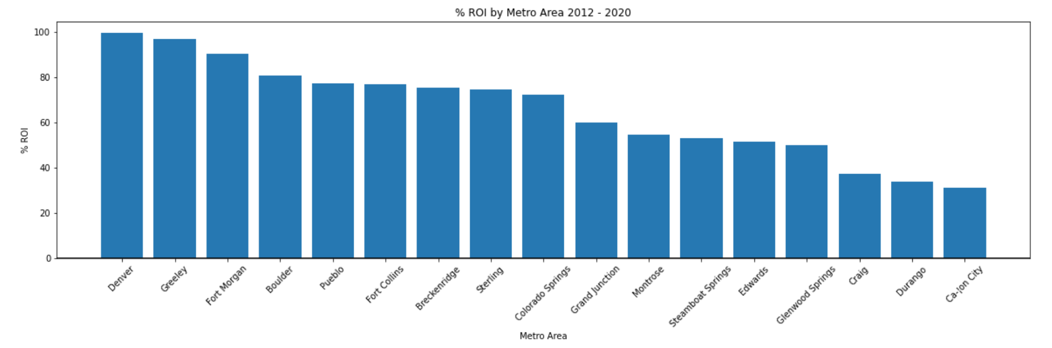
Exploratory Data Analysis
Price Distribution in State of Colorado
Averaged median home price time series analysis
Picked the 5 Colorado metro areas that had the largest increases in value from 2012 to 2020 Calculated ROI if we had bought in those cities in 2020 and sold in 2022
ROI from EDA = 36.49%

Slide 7
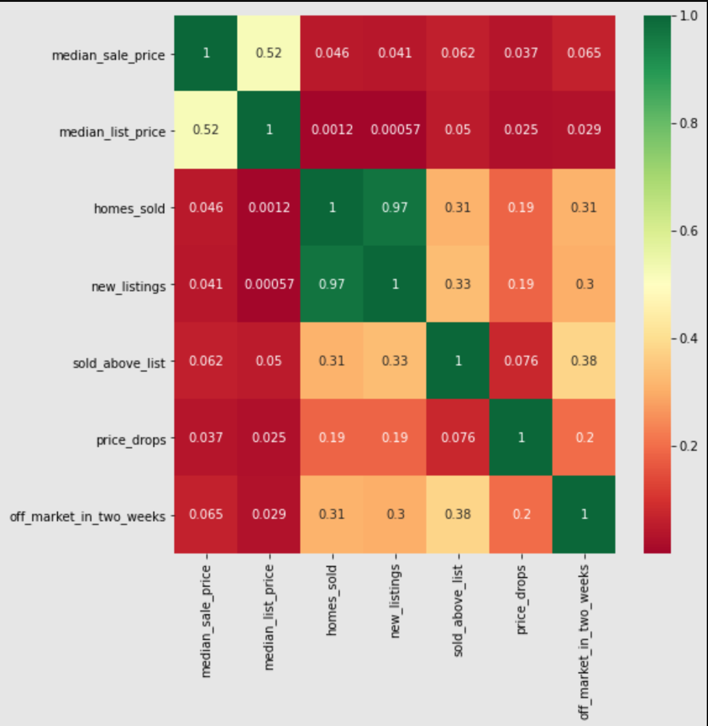
Cont. Exploratory Data Analysis
We decided to shorten our dataset to only include data from 2012 to the present to avoid the crash of 2008 negatively affecting our models.
Converted our data frame from wide format, to long format for use in our ARIMA models, and performed a train test split.
Explored Redfin data for finding correlation with other factors during same time period
Off market in two weeks and sold above price shows positive correlation. The more the houses are off market in two weeks the more the selling price of the houses.

Slide 8
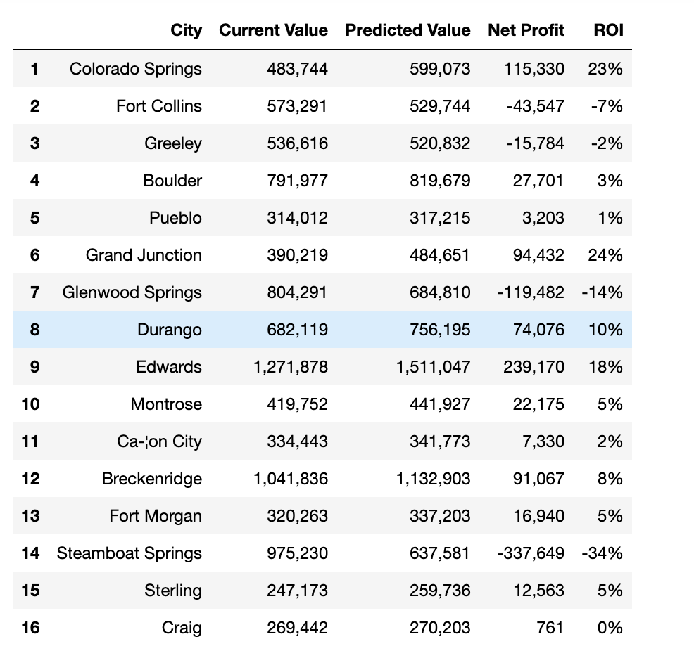
Machine Learning Model
ARIMA Models
17 Models to run auto ARIMA
Trained on data from 2012 to 2020
Validated on actual data from 2020 to 2022
Average error = 19.06%
ROI% =38.51%
Facebook Prophet Model for comparison

Slide 9
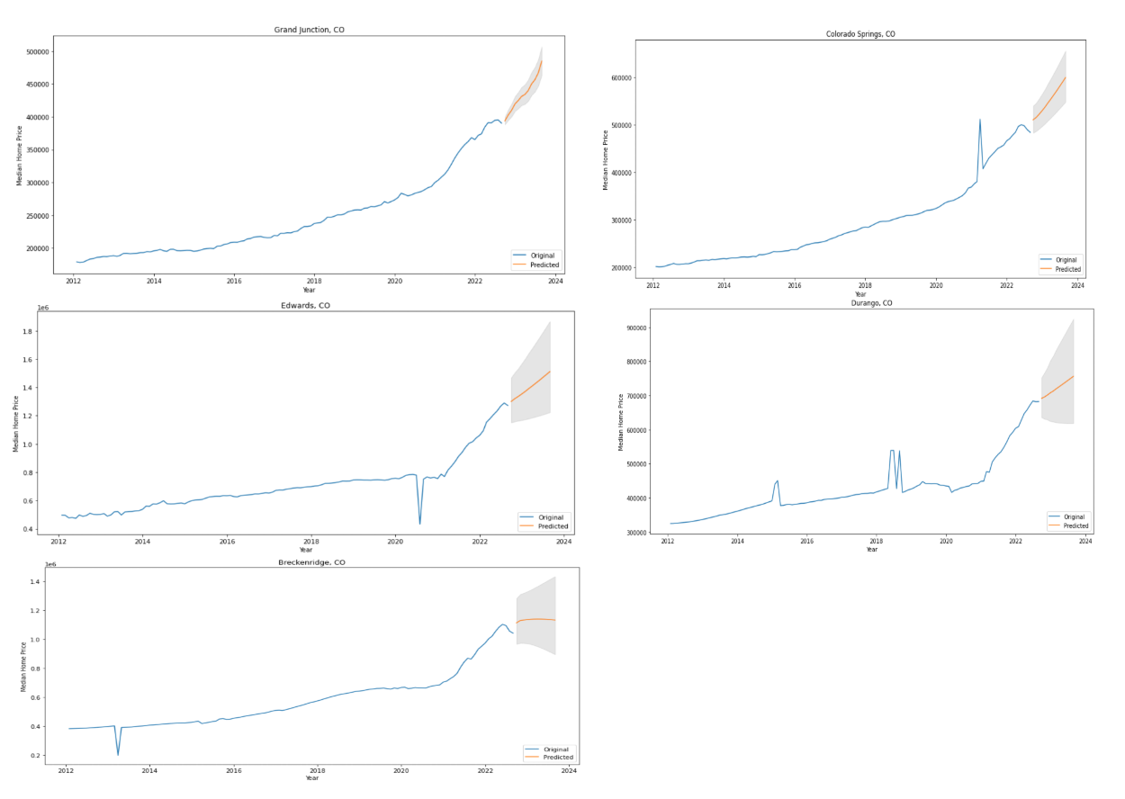
Analysis and Findings
The five metro areas recommended by our models when they were trained on the entire 2012-2020 dataset are in order of descending predicted ROI:
Grand Junction
Colorado Springs
Edwards
Durango
Breckenridge

Slide 10
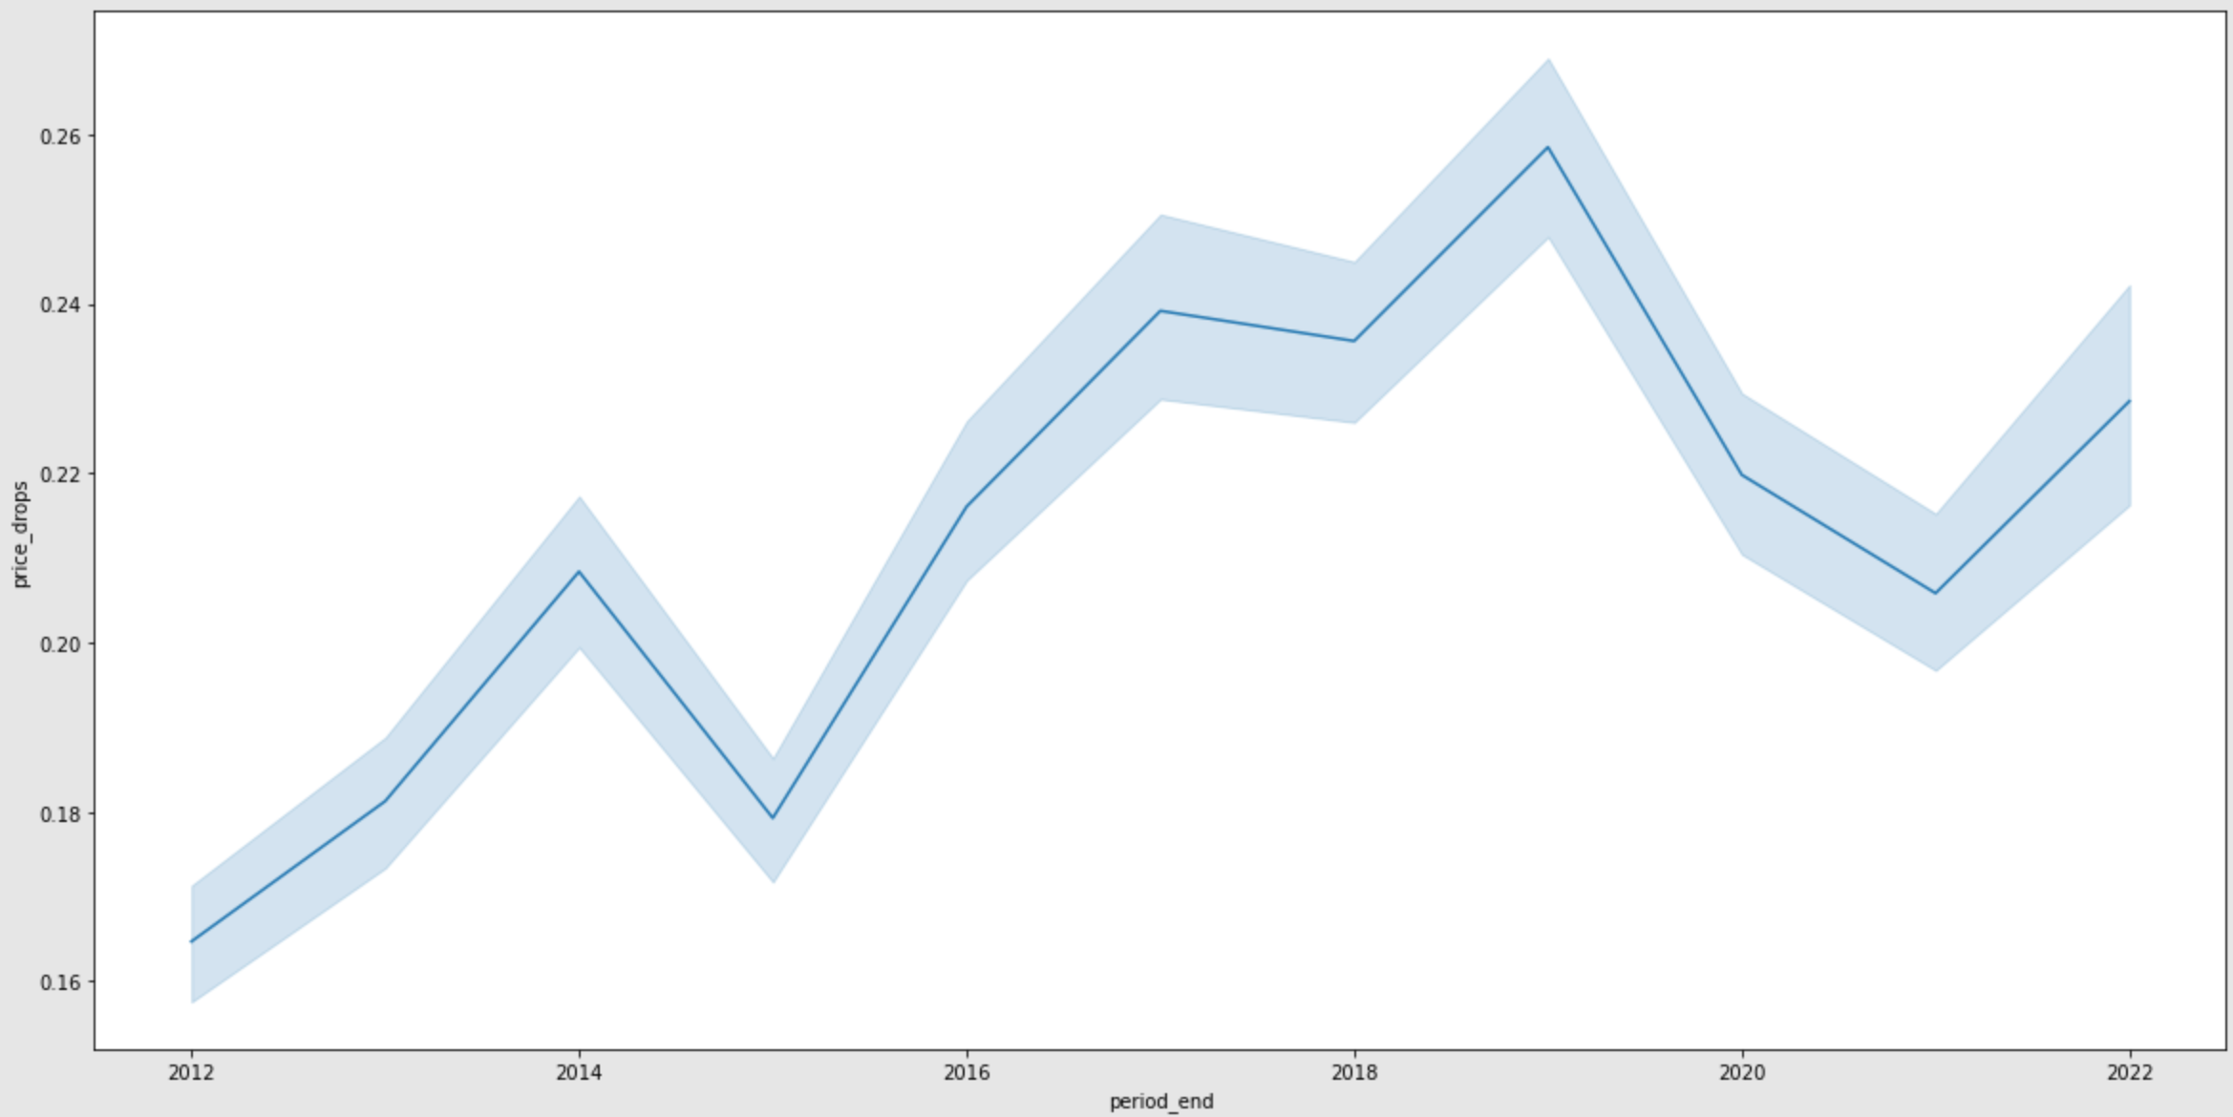
Cont. Analysis and Findings
From the analysis, ROI of EDA based approach is 36.49% whereas ROI using modeling is 38.51%
Cities Colorado Springs, Durango and Breckenridge also made it to top cities from both ARIMA Model and Facebook Prophet model predictions.
ARIMA Model outperformed an EDA based approach on the same time periods, telling us that modeling was well worth the effort.
It shows the trend of price drop percentage for the period of 2012 and 2022, where the price drop trend is rising.

Slide 11
Future Considerations
Check for other factors that Investors consider such as safety, convenience, school district, budget limit.
Build linear model with more additional features such as federal interest rate, house market safety score, etc.
Incorporate additional data about these metro areas to better understand whether median home price can really keep growing as predicted
Add metrics like population change, as well as economic and job rate data.

Slide 12
References
https://americanhomeagents.com/home-trends/is-the-colorado-housing-market-slowing-down
https://www.zillow.com/research/data/
https://www.redfin.com/news/data-center/
https://www.analyticsvidhya.com/blog/2021/10/a-comprehensive-guide-to-time-series-analysis/
Chapter 23: Using ARIMA for Time Series Analysis
https://otexts.com/fpp3/prophet.html

Slide 13
Thank you!
I would like to thank Professor Christy Pearson and everyone in this class. It was a great learning and working experience in this class.

